Slide 1
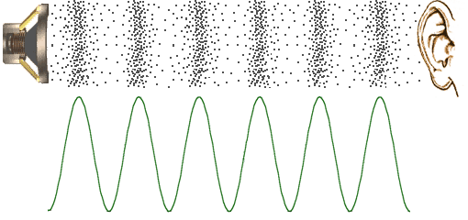
Basics of SOUND
Chapter 2

Slide 2

INTRODUCTION OF MECHANICAL WAVES & SOUND
Ultrasound medical imaging | Mechanical waves and sound | Physics | Khan Academy

Slide 3
All waves carry energy from one location to another
CYCLICAL/RHYTHMIC
A sound wave carries energy that was caused by a mechanical action -
in the case of diagnostic ultrasound, the transducer creates energy in the form of sound pulses that move through body tissues
Sound cannot travel through a vacuum;
it can travel via the molecules in the medium when they are squeezed together then stretched apart…
WAVES

Slide 4
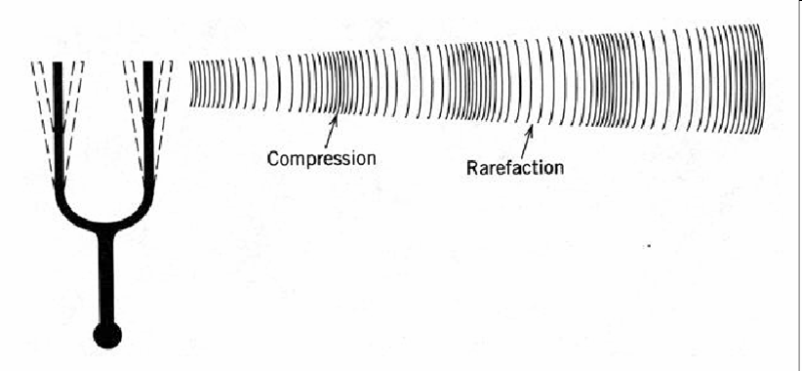
Sound is propagated through a medium by compression and rarefaction of the molecules in the path of the sound.
Notes:
The compressions and rarefactions alternate creating “cycles”…we will learn a lot about the variables and parameters associated with cycles!

Slide 5
ACOUSTIC VARIABLES
When a wave travels, certain variables within the medium will change.
The variables particular to sound waves are known as acoustic variables.
When Pressure, Density, or Distance, is noted to rhythmically oscillate we know that a sound wave (acoustic wave) is present.
Notes:
These are important! If something other than those rhythmically oscillate, it is not a sound wave.

Slide 6
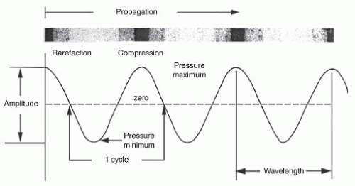
COMPRESSION – MOLECULES ARE BEING SQUEEZED TOGETHER
Which variables apply to
compression? rarefaction?
RAREFACTION – MOLECULES ARE BEING STRETCHED APART

Slide 7
Acoustic Variable | Units
Pressure | Pascals (Pa)
Density | Kg/cm³
Distance | cm, mm
Pressure: Concentration of force in an area
Density: Concentration of mass in a volume
Distance: How far apart objects are OR Measure of particle motion or displacement (vibration)
Notes:
Let’s define the terms

Slide 8
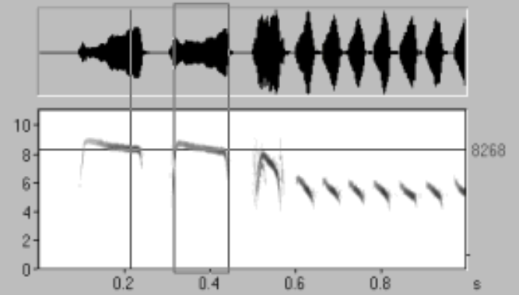
ACOUSTIC PARAMETERS
After we are aware that a sound wave is present,
it is important to describe (measure) its features and characteristics.
7 Acoustic parameters are used to describe sound waves:
Period
Frequency
Amplitude
Power
Intensity
Wavelength
Propagation speed
Notes:
Parameters are measurable quantities. Once you identify a person, how do you describe them? Tall, strong, fast, intense? More in ch 3

Slide 9
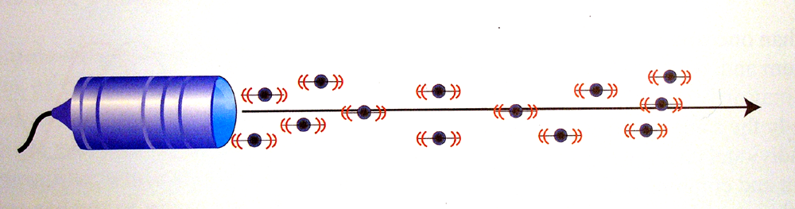
Longitudinal Waves
Sound energy travels in a straight line - the same direction as the wave is moving.
Therefore, sound waves are longitudinal waves
Notes:
Back to the basic sound wave…we said it was mechanical (caused by a mechanical action), now we are learning that

Slide 10
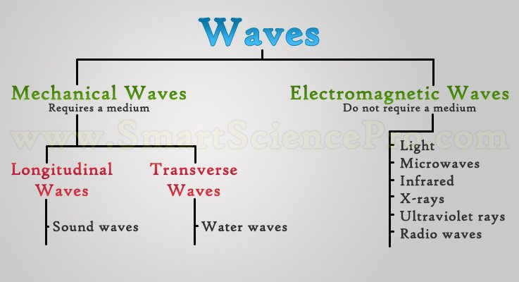
Key difference between mechanical and electromagnetic: mechanical waves need a medium to propagate *remember “m” for medium
Notes:
For comparison – there are other types of waves - In transverse waves, the particles move up and down (90 degrees) while the energy moves forward. Think of a boat bobbing up and down while waves pass by.

Slide 11
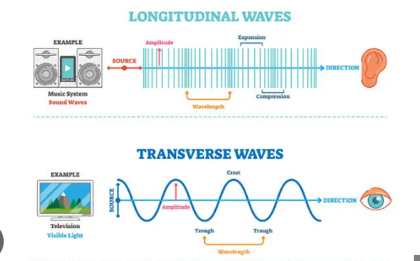
Longitudinal vs. Transverse Waves
Particles in Longitudinal waves move in parallel to the direction in which the energy is travelling.
Particles in Transverse waves move perpendicularly to the direction the energy is travelling.
Notes:
exercising with a weighted rope - you’re moving the rope up and down, but the wave of the rope is moving forward

Slide 12
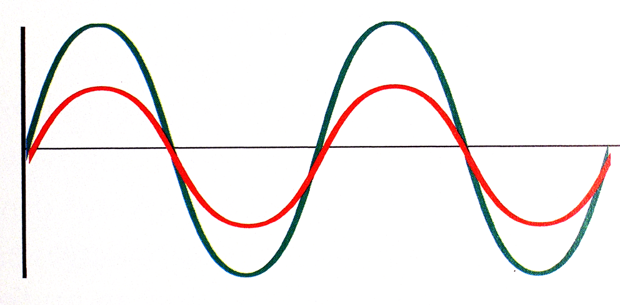
IN PHASE WAVES
In-Phase means the waves’ peaks and troughs match precisely.
Notes:
When more than one sound wave is present…

Slide 13
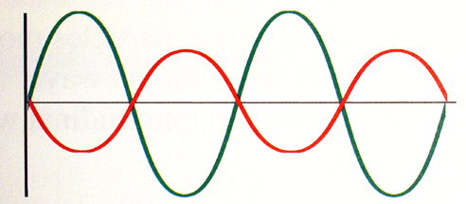
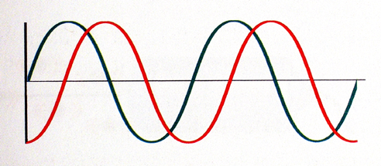
OUT-OF-PHASE WAVES
Out- of -phase means the waves’ peaks and troughs occur at different times

Slide 14

INTERFERENCE
*In-Phase and Out-of-Phase waves undergo interference…
When more than one sound wave travels through a medium, multiple beams may arrive at a given point simultaneously
At that time, they lose their individuality and combine to form one wave.
Notes:
The amplitude of that wave will vary… Think of a trampoline…

Slide 15

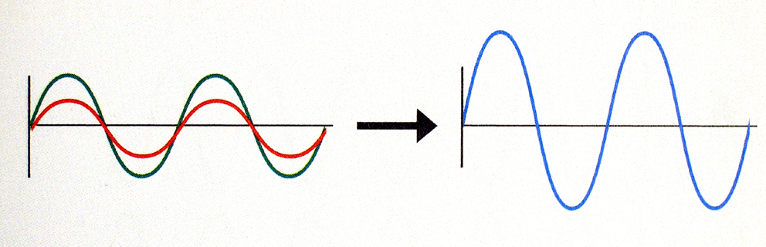
Constructive interference:
in-phase waves combine to form one wave with a resulting increase in amplitude
Notes:
https://www.youtube.com/shorts/b44wIP0IJZY

Slide 16
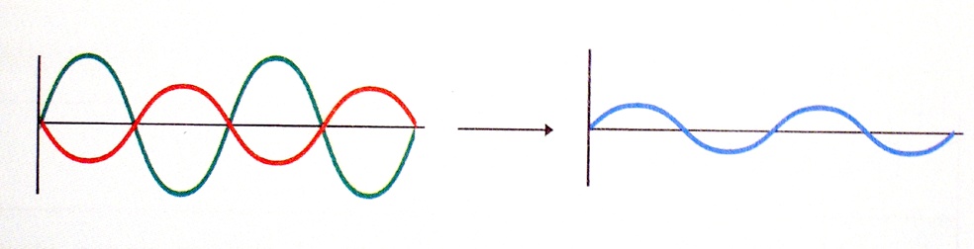
Destructive interference:
out-of-phase waves combine and form a single wave with a smaller amplitude.
Note: the resultant amplitude is smaller than at least one component.

Slide 17
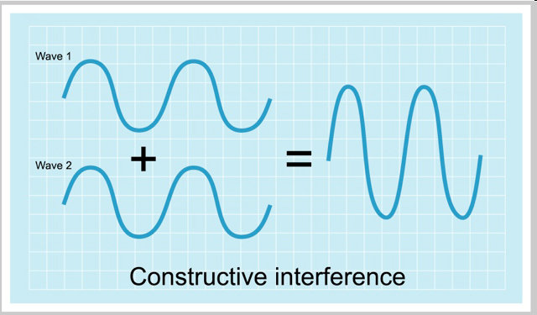
INTERFERENCE

Slide 18
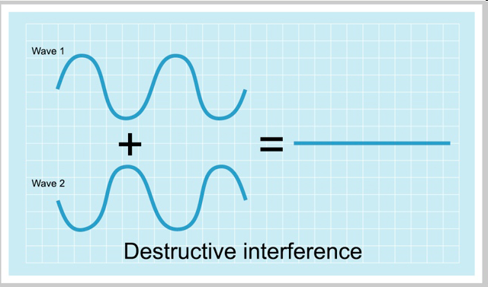
Equal Amplitude
Notes:
This type of complete destructive interference occurs when waves are of equal amplitude

Slide 19
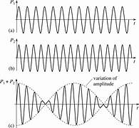
Interference
Differing Frequencies
When waves of different frequencies interfere with each other constructive and destructive interference can result.
Notes:
We didn’t recognize yet that the previous examples were all of sound waves of the same frequency.

Slide 20
REVIEW
Sound is a form energy that travels by the movement of molecules in pressure waves
Sound MUST travel through a medium
Sound cannot travel through a vacuum
Sound travels in a straight line
Sound is a mechanical longitudinal wave

Slide 21
REVIEW
Sound waves are comprised of compressions and rarefactions
What is a compression?
What is a rarefaction?

Slide 22
REVIEW
Sound waves are identified by changes in acoustic variables.
How many acoustic variables?
What are they?

Slide 23
REVIEW- ACOUSTIC VARIABLES
Pressure: concentration of force in an area
Density: concentration of mass in a volume
Distance: measure of particle motion

Slide 24
REVIEW
The features of sound waves are described by acoustic _?
How many are there?
What are they?

Slide 25
REVIEW
7 Acoustic parameters are used to describe the features of sound waves.
Period
Frequency
Amplitude
Power
Intensity
Wavelength
Propagation speed

Slide 26
REVIEW
What does it mean when waves are in phase?
What does it mean when waves are out-of-phase?
Notes:
Peaks occur at same time/same location
Peaks and troughs occur at different times

Slide 27
REVIEW
What will occur when two waves of different frequencies interfere?
Notes:
Constructive and destructive interference occur

